Slide 1
TX FIR Equalizer
12 Gbps
(Pulse Response)
Muhammad Aldacher

Slide 2
Design Parameters
Parameter | Value
Data Rate | 12 Gb/s
VDD | 1 V
Tx-Driver | Current Mode (CML)
VSWING (PK2PK) | 0.5 V
IBIAS | 10mA
Channel | 12-inch FR4

Slide 3
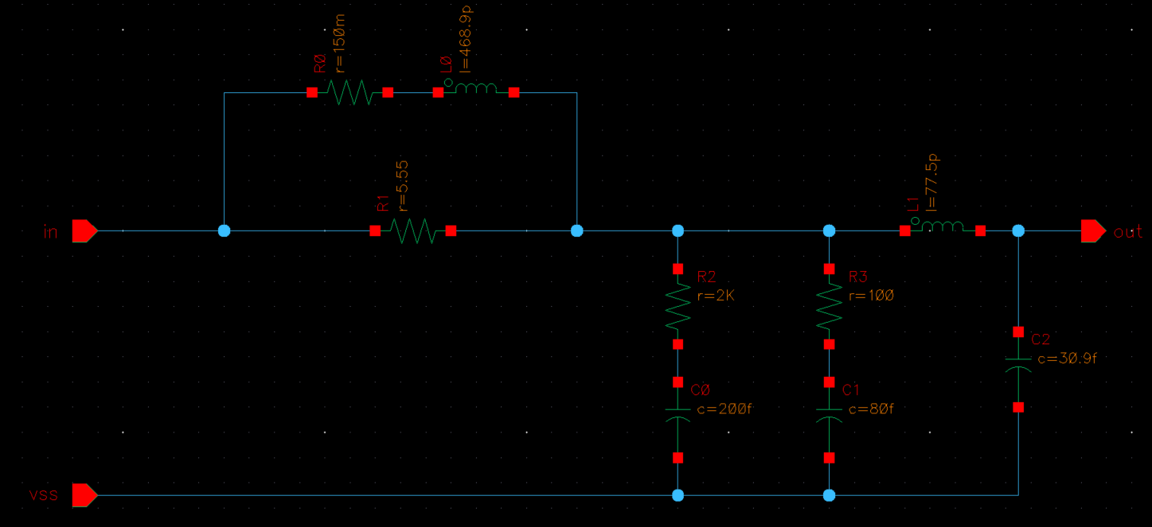
Channel = 12 x 1-inch FR4 section
1-inch FR4 section

Slide 4
1) Pulse Response (without Equalization)

Slide 5
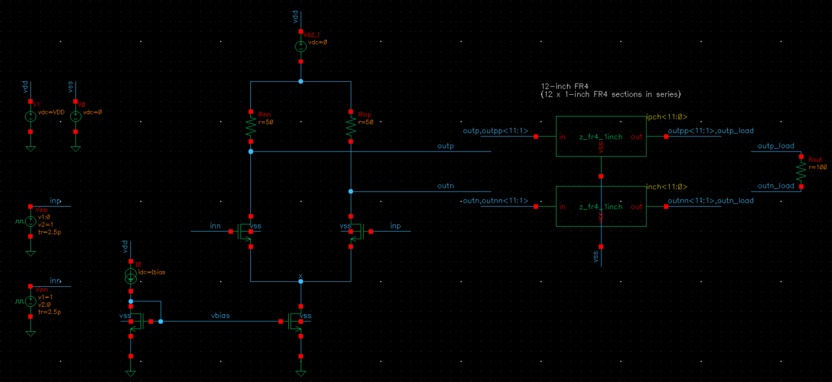
TB Schematics
LIB: analogLib
CELL: vpulse
Voltage1: 0 V / 1 V
Voltage2: 1 V / 0 V
Period: 10u
Delay time: 1 ns
Rise/Fall times: 2.5 ps
Pulse width: 83.33ps (1/12G)
IMAIN=10mA
m=100 L=LMIN
m=100 L=LMIN
m=200 L=4*LMIN
m=200 L=4*LMIN

Slide 6
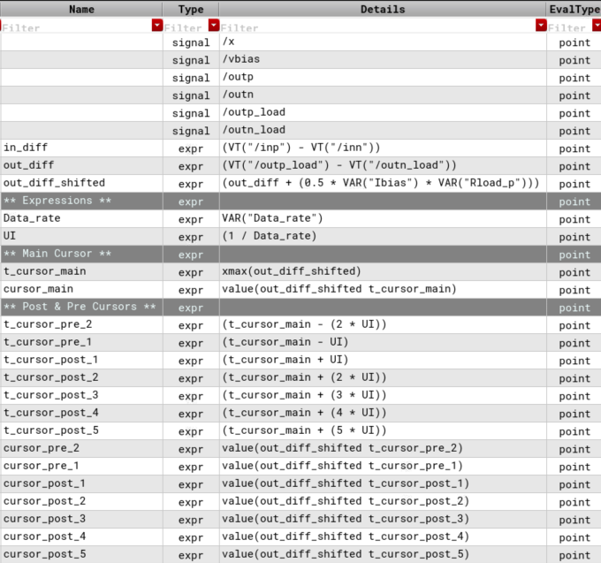
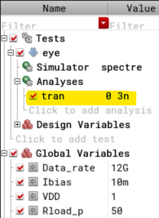
Analysis Setup

Slide 7
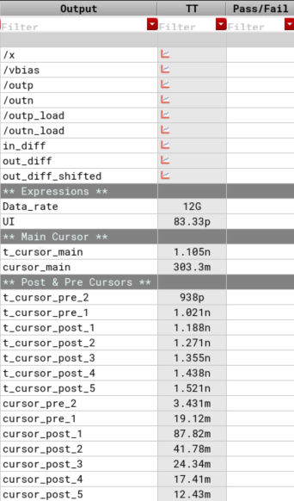
Results

Slide 8
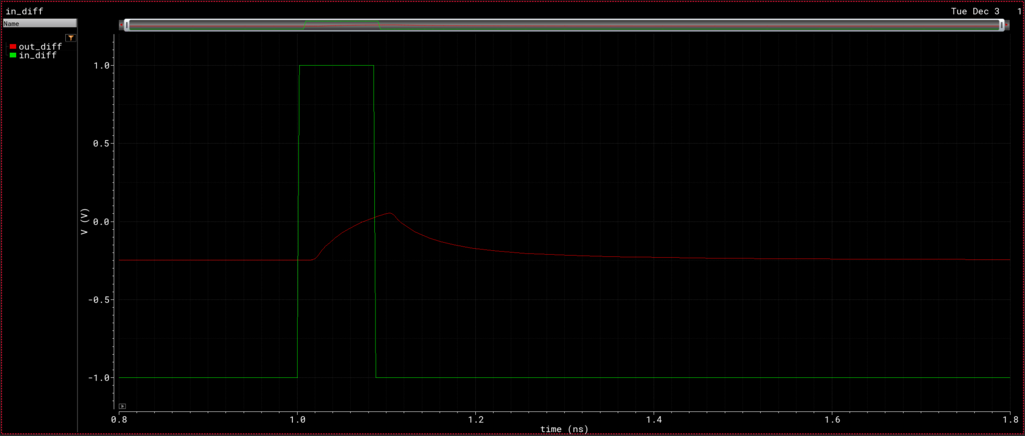
Waveforms
“out_diff” = outp_load – outn_load
“in_diff” = inp – inn

Slide 9
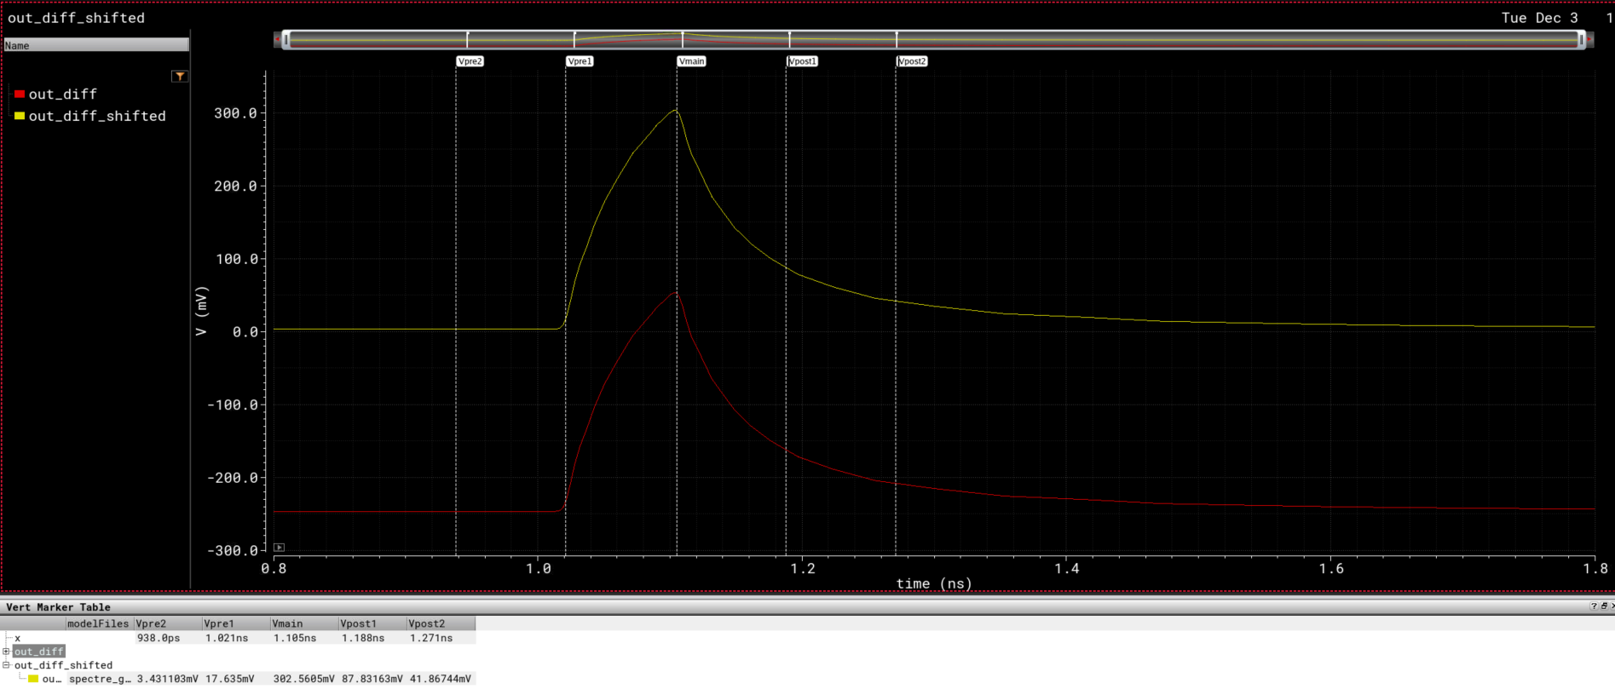
Waveforms
The waveform is shifted up to zero (+250mV), so we could find the cursor values in terms of VSWING(PK2PK) = IBIAS * RLOAD
“out_diff” is the Voltage across the 100-Ohm Rload. Ideally, it would go from -250mV to +250mV.

Slide 10
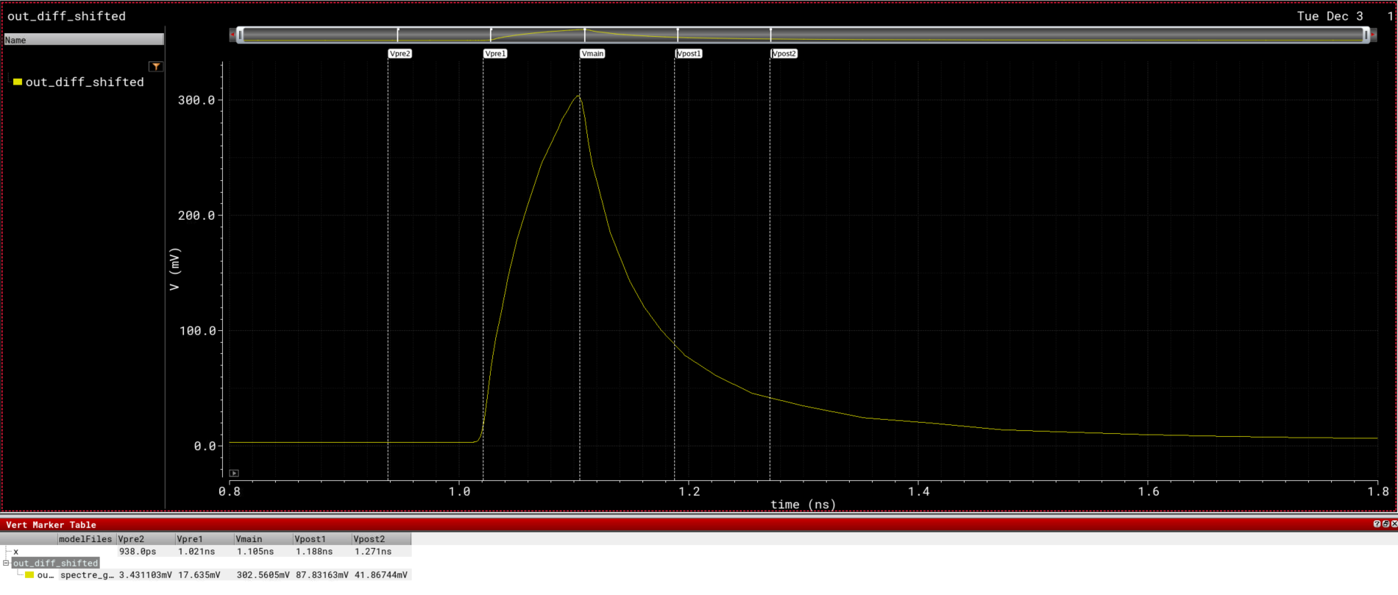
Waveforms
 | Pre- Cursor1 | Main- Cursor | Post- Cursor1 | Post- Cursor2
Adjusted VSWING(PK2PK) | (18 / 303) * 500 mV = 29.7 mV | (303 / 303) * 500 mV = 500 mV | (88 / 303) * 500 mV = 145.2 mV | (42 / 303) * 500 mV = 69.3 mV
Equivalent IBIAS | 29.7 mV / 50 Ohms = 0.6 mA | 500 mV / 50 Ohms = 10 mA | 145.2 mV / 50 Ohms = 2.9 mA | 69.3 mV / 50 Ohms = 1.4 mA
# of fingers | (m = 12) | (m = 200) | (m = 58) | (m = 28)
Pre-Cursor1 = 18mV
Main-Cursor = 303mV
Post-Cursor1 = 88mV
Post-Cursor2 = 42mV

Slide 11
2) Pulse Response (with Equalization)

Slide 12
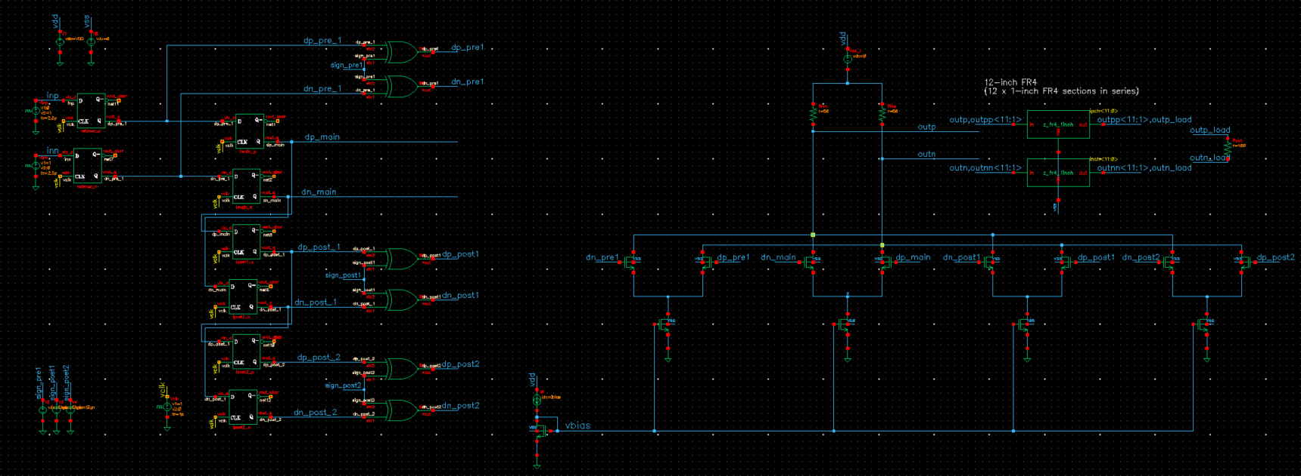
TB Schematics
LIB: analogLib
CELL: vpulse
Voltage1: 0 V / 1 V
Voltage2: 1 V / 0 V
Period: 10u
Delay time: 11 ns
Rise/Fall times: 2.5 ps
Pulse width: 83.33ps (1/12G)
Pre1
Main
Post1
Post2
* Delay time is increased to make sure that we start the pulse response measurements with steady-state levels.
IPRE1=0.6mA
IMAIN=10mA
IPOST1=2.9mA
IPOST2=1.4mA
m=12 L=4*LMIN
m=200 L=4*LMIN
m=58 L=4*LMIN
m=28 L=4*LMIN
IMAIN=10mA
m=200 L=4*LMIN

Slide 13
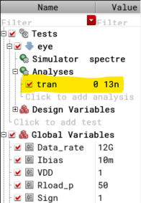
Analysis Setup

Slide 14
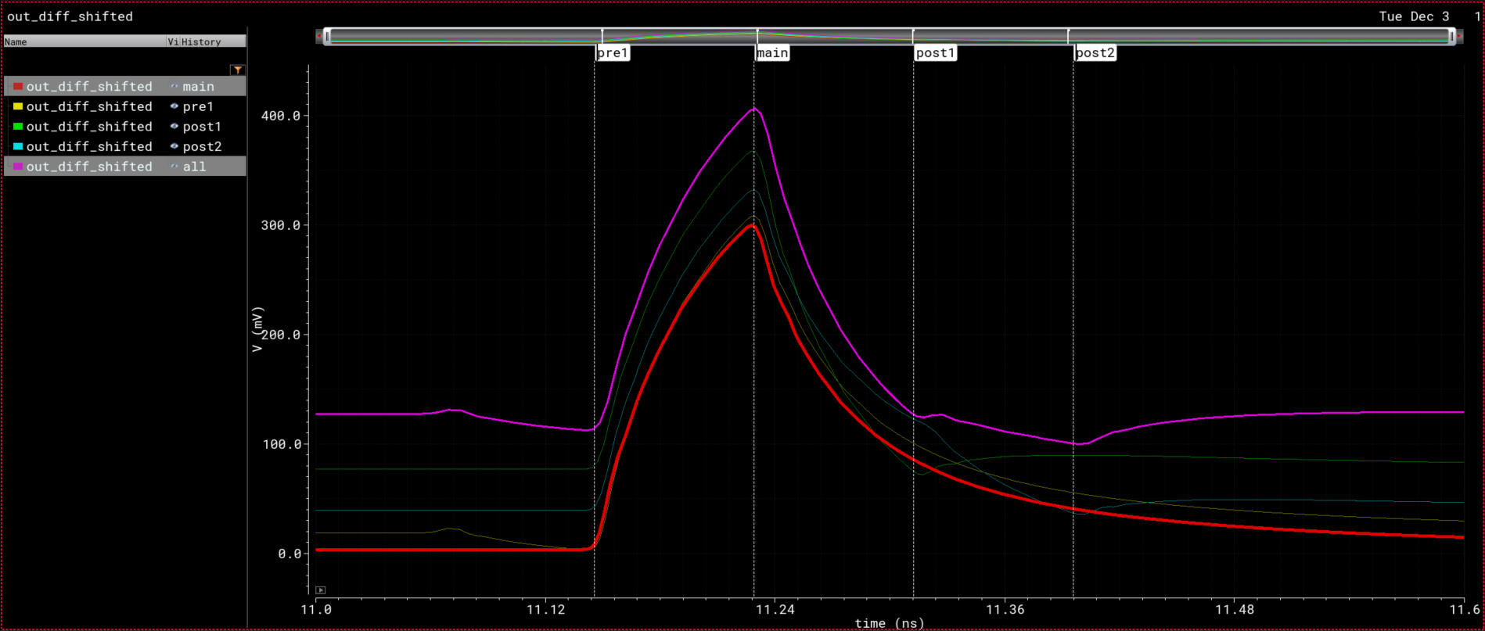
Waveforms
No Equalization
Pre-Cursor1 Eq only
Post-Cursor1 Eq only
Post-Cursor2 Eq only
4-tap Eq (1pre, main, 2post)

Slide 15
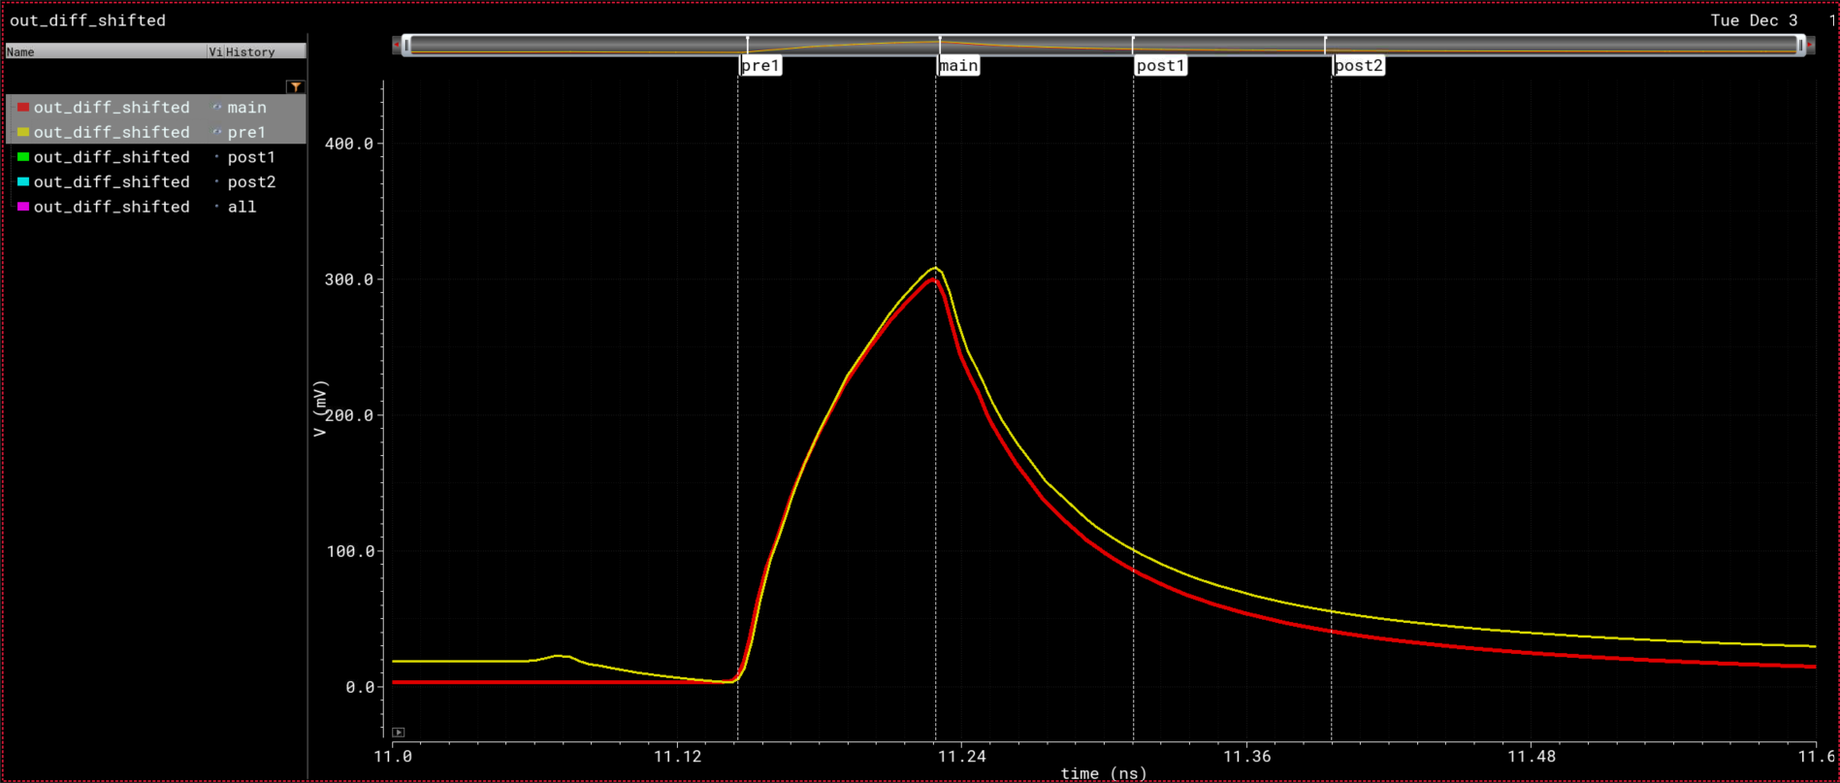
Waveforms
No Equalization
Pre-Cursor1 Eq only

Slide 16
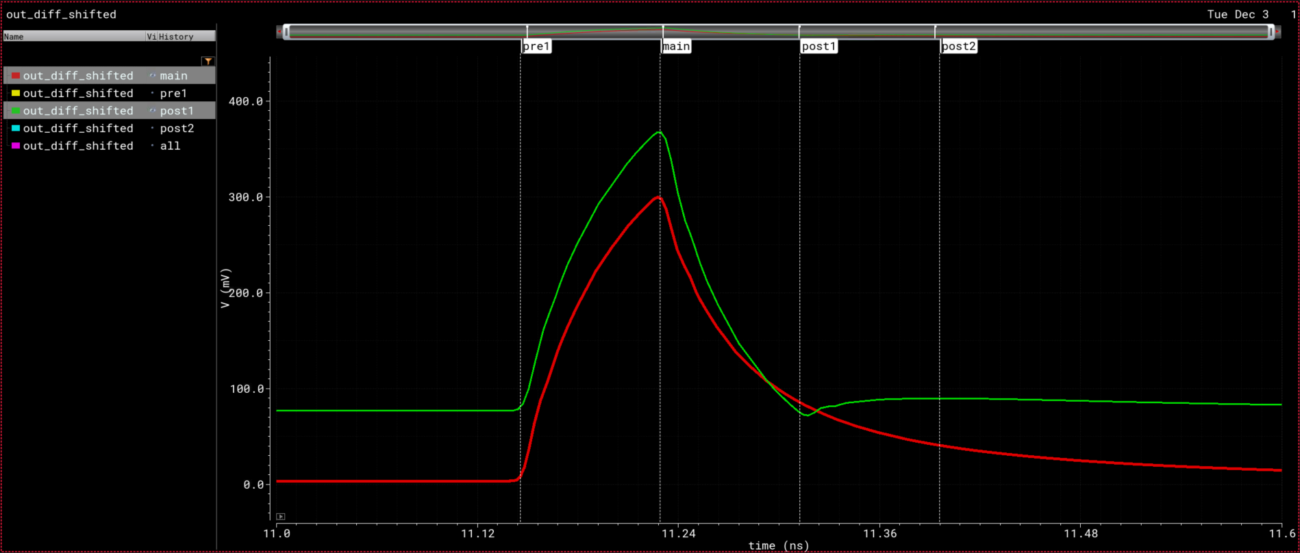
Waveforms
No Equalization
Post-Cursor1 Eq only

Slide 17
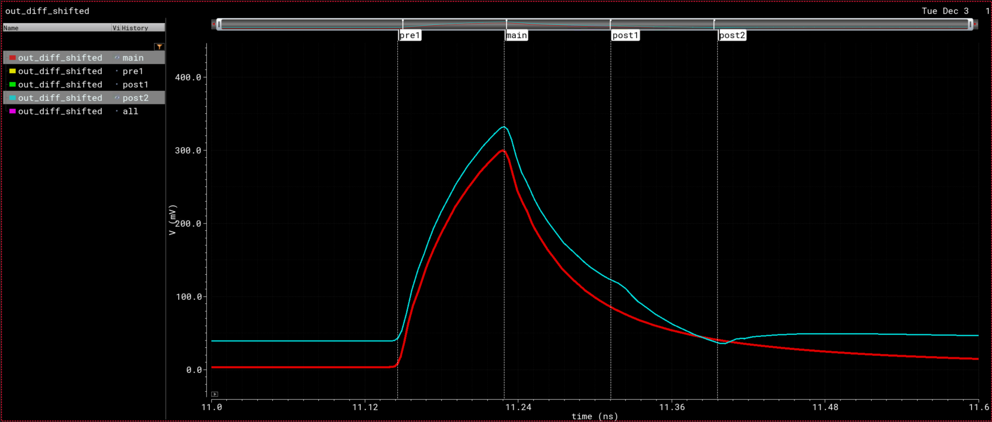
Waveforms
No Equalization
Post-Cursor2 Eq only

Slide 18
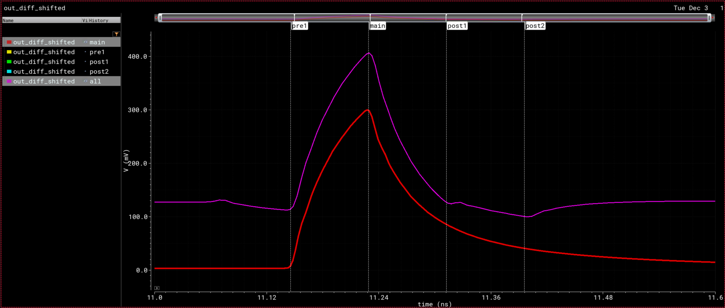
Waveforms (with all taps)
No Equalization
4-tap Eq (1pre, main, 2post)

